Slide 1
RASD Discussion
Pietro Melzi, Alessandro Pina, Matteo Salvadore

Slide 2
Goals of the system
A visitor should be able to:
[G1 ] sign up into the system;
A user should be able to:
[G2 ] log into the system;
[G3 ] create an event specifying its location, date, starting and ending time;
[G4 ] obtain the best travel path (according to his preferences) and the list of eventual feasible alternatives to reach a location;
[G5 ] change the selected path with an alternative one;
[G6 ] obtain a daily schedule that allows him to attend every event in program;
[G7 ] apply constraints on travel means;
[G7.1 ] related to the length of travel;
[G7.2 ] related to the period of day;
[G8 ] deactivate one or more travel means;
[G9 ] select combinations of transportation means that minimize carbon footprint;
[G10 ] reserve time for lunch or break events;
[G11 ] arrange trips;
[G11.1 ] buy needed tickets;
[G11.2 ] nd available sharing vehicles.

Slide 3
System Boundaries
Allowed travel means are cars, trains, metro, on foot, trams, bicycles, taxis, car sharing, bike sharing;
The mobile app is supported on:
Android 6.0 and superior;
iOS 8 and superior;
To utilize the mobile app, the phone must be able to connect to the Internet and have a working GPS sensor to identify its position.
The web app is supported on these browsers: Google Chrome, Mozilla Firefox, Microsoft Edge, Safari. Other browsers may be utilized to access the web app, but full compatibility is not guaranteed.

Slide 4
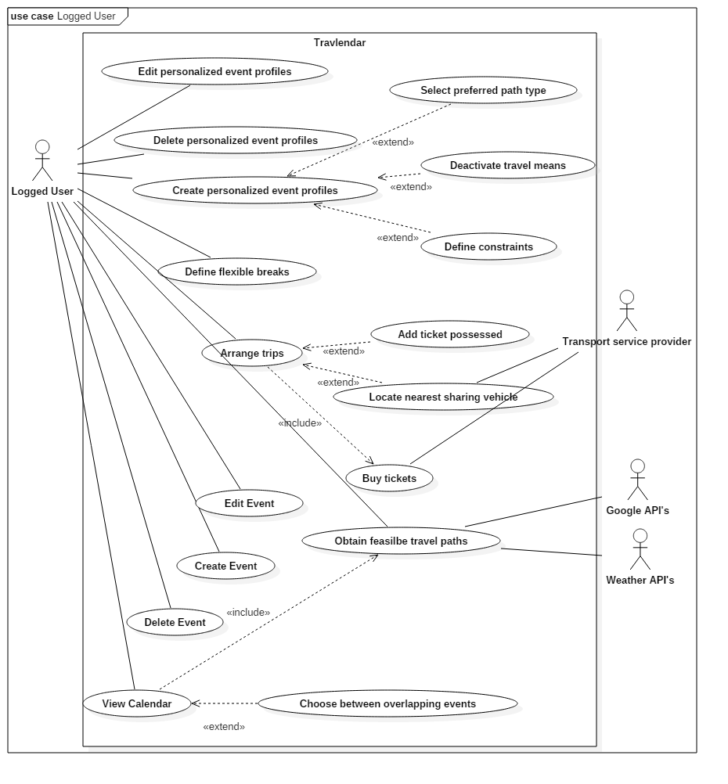
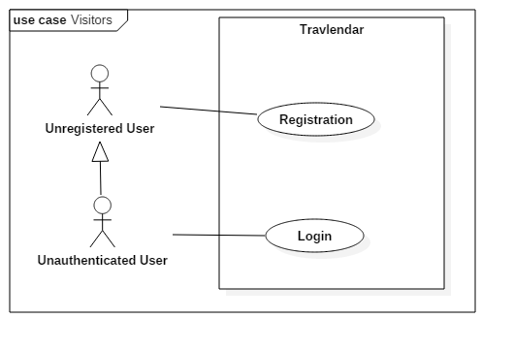
Meaningful use cases

Slide 5
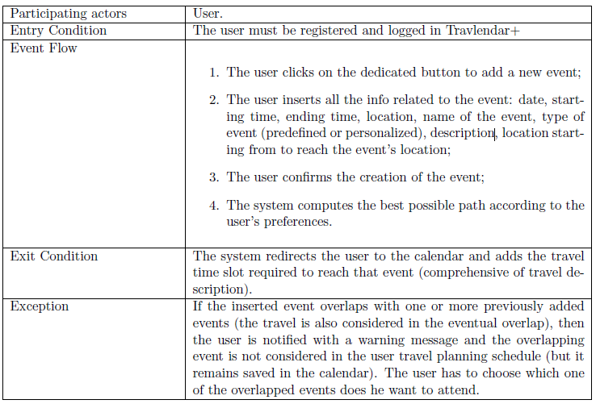
[UC4] Create event

Slide 6
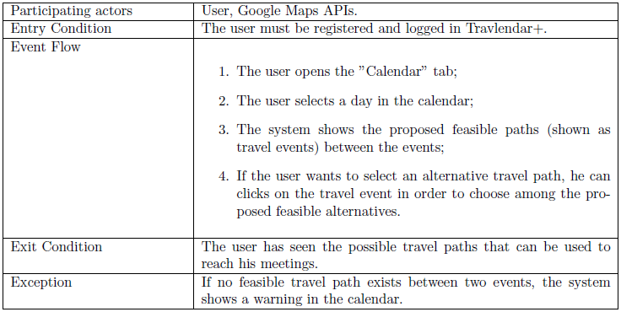
[UC10] Obtain feasible travel paths

Slide 7
Most important requirements
[R10 ] every travel path proposed must be feasible in the available time (the interval between two consecutive events);
[R12 ] the system does not consider paths that violate constraints on travel means defined by the user;
Related to: [G4 ] obtain the best travel path (according to his preferences) and the list of eventual feasible alternatives to reach a location.
[R21 ] if there are multiple events at the same time the system will propose in the schedule only the first event added.
[R22 ] if the user forces into the schedule an event that overlaps with events already present in the schedule, these are removed from the schedule.
Related to: [G6 ] obtain a daily schedule that allows him to attend every event in program.

Slide 8
Most important assumptions
[D4 ] an event to attend cannot be in the past;
[D7 ] a person can travel only on one travel mean at once;
[D8 ] allowed travel means are cars, trains, metro, on foot, trams, bicycles, taxis, car sharing, bike sharing;
[D9 ] every travel is programmed with a combination of one or more travel means;
[D10] a person can be only in one place at once;

Slide 9
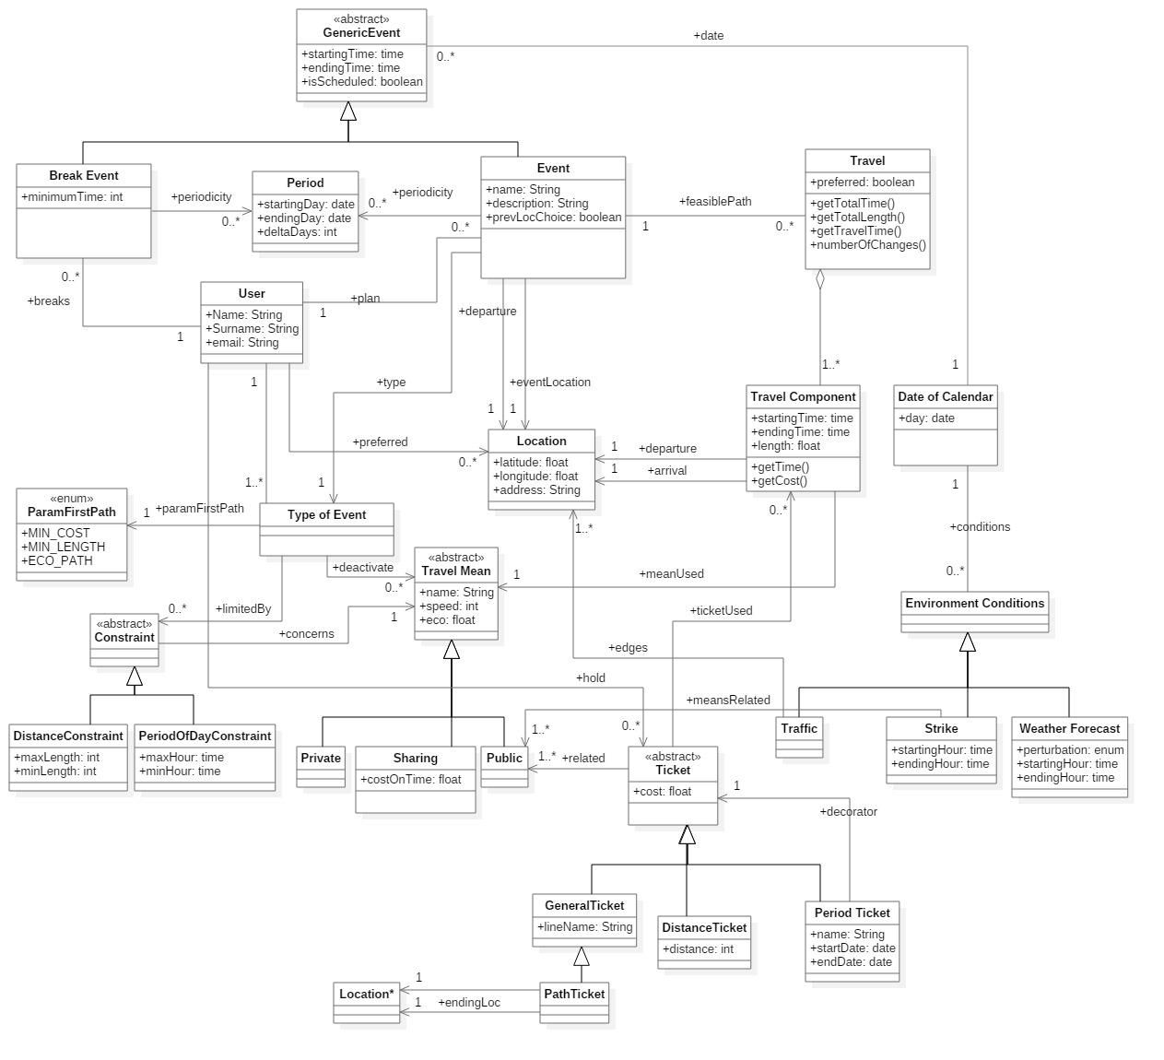

Slide 10
Alloy model
Our Alloy code, is used to describe and check the consistency of our model (see also the class diagram) using a formal notation and to provide examples of the possible worlds generated by the Alloy analyzer tool.
We've described the domain of our model and his main properties and we've also modeled some main operations to be provided by the system-to-be. Therefore we've proven the consistency of our model and we’ve used the results to refine our specifications contained into this document; during the alloy’s modeling effort we've point out some flaws of our assumptions and of our UML models and so we’ve fixed it.

